Slide 1
Визуализация данных
Лекции доступны онлайн по адресу
http://github.com/a-vodka/dv

Slide 2
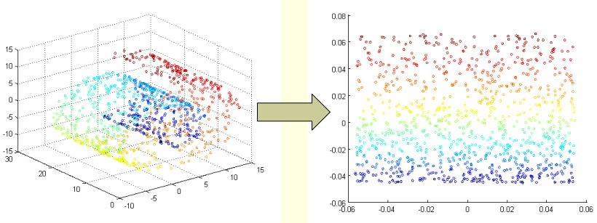
Dimensionality Reduction

Slide 3
Dimensionality Reduction
Simple example
3-D data
Y
Z
X
Y
Y
X
Z

Slide 4
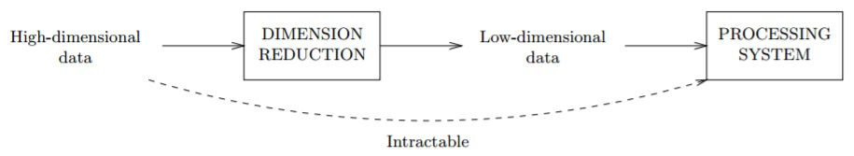
Motivation
Widely used in
language processing
Image processing
Denoising
Compressing

Slide 5
Dimension Reduction Overview
Parametric
(LDA)
Linear
(PCA)
Dimension reduction
Non-
parametric
Global
(ISOMAP)
Nonlinear
Local
(LLE, SNE)

Slide 6
Dimensionality Reduction
Linear method
PCA (Principle Component Analysis)
Preserves the variance
Non-linear method
ISOMAP
LLE
tSNE
Laplacian
Diffusion map
KNN Diffusion
A global geometric framework for nonlinear dimensionality reduction, J.B.Tenenbaum, V.De Silva, J.C.Langford (science 2000)
Nonlinear Dimensionality Reduction by Locally Linear Embedding, Sam T. Roweis and Lawrence K. Saul (science 2000)
Visualizing Data using t-SNE,
Laurens van der Maaten, Geoffrey Hinton (Journal of machine learning research 2008)

Slide 7
PCA
x₁
x₁
λ₁e₁
λ₂e₂
x₀
x₀
λ_{k} is the marginal variance along the principle direction e_{k}

Slide 8
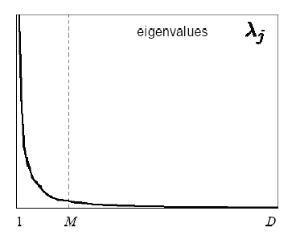
PCA
Projecting onto e₁ captures the majority of the variance and hence it minimizes the error.
x₁
x₁
λ₁e₁
Reduction
λ₁e₁
λ₂e₂
λ₂e₂
x₀
x₀
Choosing subspace dimension M:
Large M means lower expected error in the subspace data approximation

Slide 9
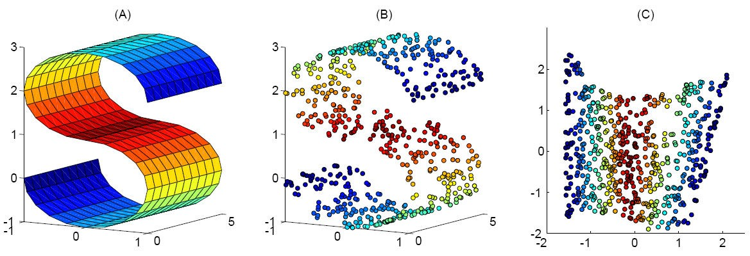
Nonlinear Dimensionality Reduction
Many data sets contain essential nonlinear structures that invisible to PCA.

Slide 10
PCA

Slide 11
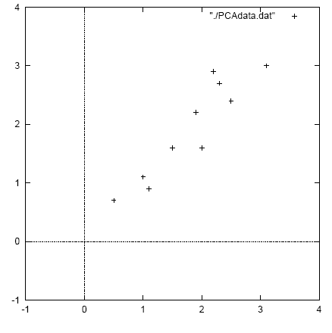
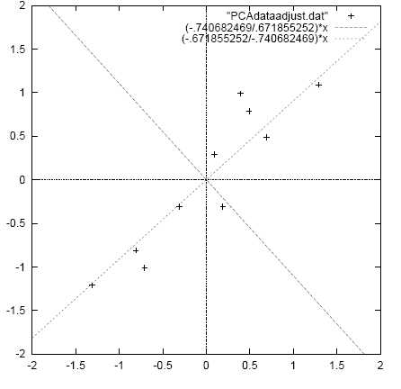
PCA example (1)
original data
mean centered data with
PCs overlayed

Slide 12
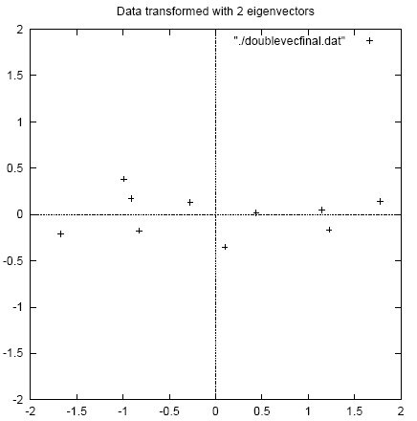
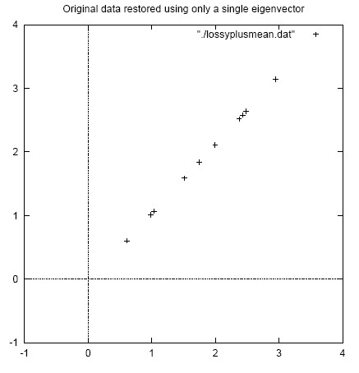
PCA example (1)
original data projected
Into full PC space
original data reconstructed using
only a single PC

Slide 13
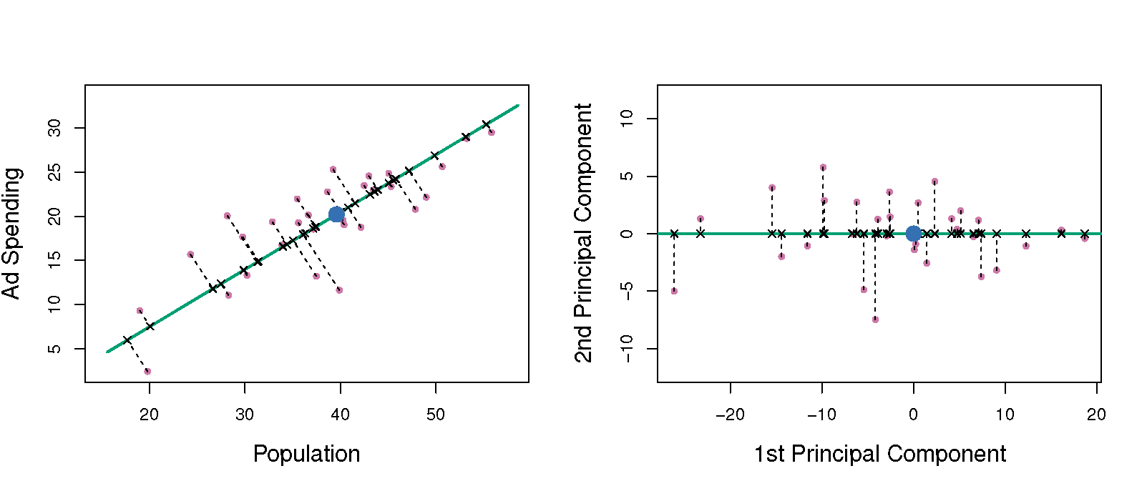
PCA example (2)

Slide 14
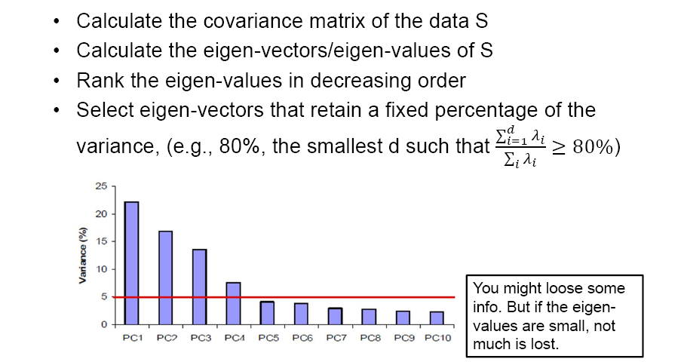
PCA: choosing the dimension k

Slide 15
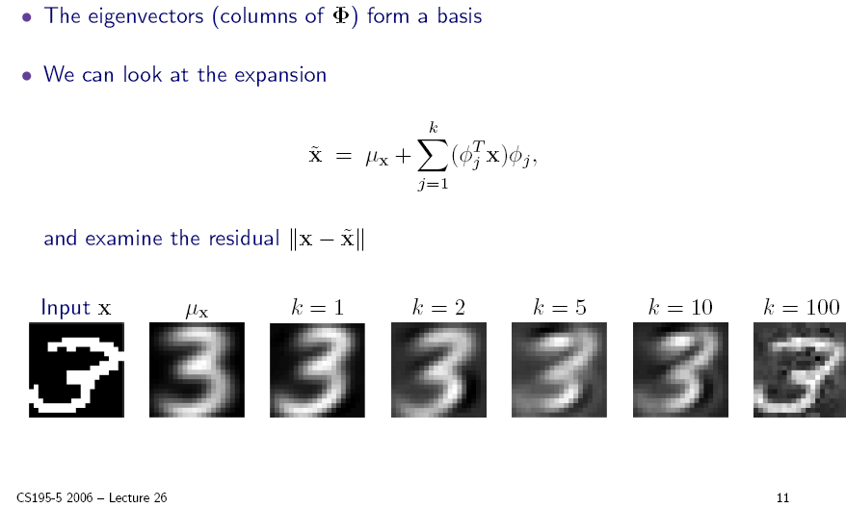
PCA: choosing the dimension k

Slide 16
PCA example: face recognition
A typical image of size 256 x 128 pixels is described by 256 x 128 = 32768 dimensions.
Each face image lies somewhere in this high-dimensional space.
Images of faces are generally similar in overall configuration, thus
They cannot be randomly distributed in this space.
We should be able to describe them in a much lower-dimensional space.

Slide 17
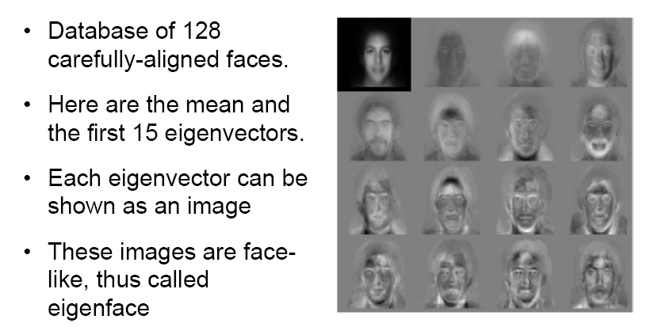
PCA for face images: eigenfaces

Slide 18
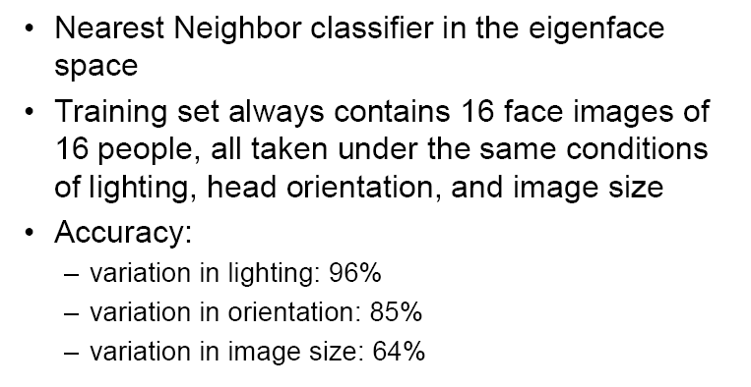
Face recognition in eigenface space
(Turk and Pentland 1991)

Slide 19
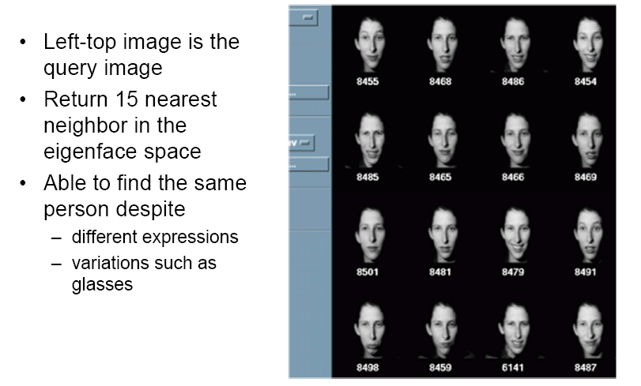
Face image retrieval

Slide 20
PCA: a useful preprocessing step
Helps reduce computational complexity.
Can help supervised learning.
Reduced dimension ⇒ simpler hypothesis space.
Smaller VC dimension ⇒ less risk of overfitting.
PCA can also be seen as noise reduction.
Caveats:
Fails when data consists of multiple separate clusters.
Directions of greatest variance may not be most informative (i.e. greatest classification power).

Slide 21
Scaling up PCA
Practical issue: covariance matrix is n x n.
E.g. for image data Σ = 32768 x 32768.
Finding eigenvectors of such a matrix is slow.
Singular value decomposition (SVD) to the rescue!
Can be used to compute principal components.
Efficient implementations available, e.g. MATLAB svd.

Slide 22
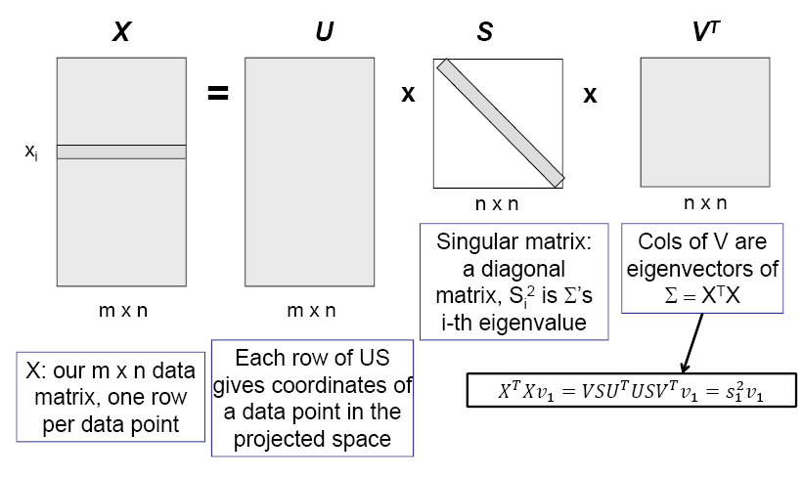
Singular value decomposition (SVD)
X = U⋅S⋅V^{T}

Slide 23
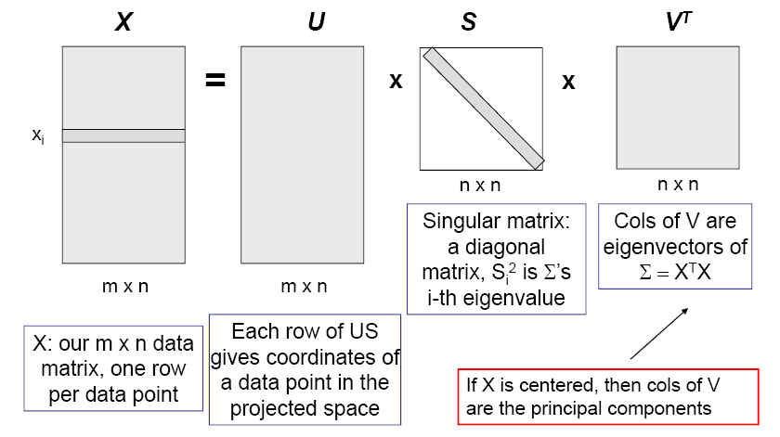
Singular value decomposition (SVD)
X = U⋅S⋅V^{T}

Slide 24
SVD for PCA
Create mean-centered data matrix X.
Solve SVD: X = U⋅S⋅V^{T}.
Columns of V are the eigenvectors of Σ sorted from largest to smallest eigenvalues.
Select the first k columns as our k principal components.

Slide 25
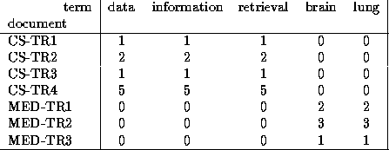
Singular Value Decomposition
Problem:
#1: Find concepts in text
#2: Reduce dimensionality

Slide 26
SVD - Definition
A_{[n x m]} = U_{[n x r]} Λ _{[ r x r]} (V_{[m x r]})^{T}
A: n x m matrix (e.g., n documents, m terms)
U: n x r matrix (n documents, r concepts)
Λ: r x r diagonal matrix (strength of each ‘concept’) (r: rank of the matrix)
V: m x r matrix (m terms, r concepts)

Slide 27
SVD - Properties
THEOREM [Press+92]: always possible to decompose matrix A into A = U Λ V^{T} , where
U, Λ, V: unique (*)
U, V: column orthonormal (ie., columns are unit vectors, orthogonal to each other)
U^{T}U = I; V^{T}V = I (I: identity matrix)
Λ: singular value are positive, and sorted in decreasing order

Slide 28
SVD - Properties
‘spectral decomposition’ of the matrix:
λ₁
=
x
x
u₁
u₂
λ₂
v₁
v₂

Slide 29
SVD - Interpretation
‘documents’, ‘terms’ and ‘concepts’:
U: document-to-concept similarity matrix
V: term-to-concept similarity matrix
Λ: its diagonal elements: ‘strength’ of each concept
Projection:
best axis to project on: (‘best’ = min sum of squares of projection errors)

Slide 30
SVD - Example
A = U Λ V^{T} - example:
retrieval
inf.
lung
data
brain
CS
=
x
x
MD

Slide 31
SVD - Example
doc-to-concept
similarity matrix
A = U Λ V^{T} - example:
retrieval
CS-concept
inf.
lung
MD-concept
data
brain
CS
=
x
x
MD

Slide 32
SVD - Example
A = U Λ V^{T} - example:
retrieval
inf.
‘strength’ of CS-concept
lung
data
brain
CS
=
x
x
MD

Slide 33
SVD - Example
A = U Λ V^{T} - example:
term-to-concept
similarity matrix
retrieval
inf.
lung
data
brain
CS-concept
CS
=
x
x
MD

Slide 34
SVD – Dimensionality reduction
Q: how exactly is dim. reduction done?
A: set the smallest singular values to zero:
=
x
x

Slide 35
SVD - Dimensionality reduction
~
x
x

Slide 36
SVD - Dimensionality reduction
~

Slide 37
ISOMAP

Slide 38
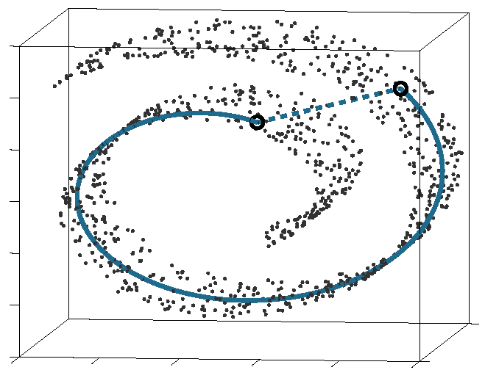
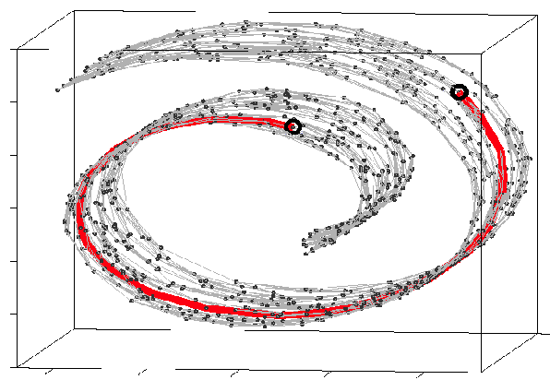
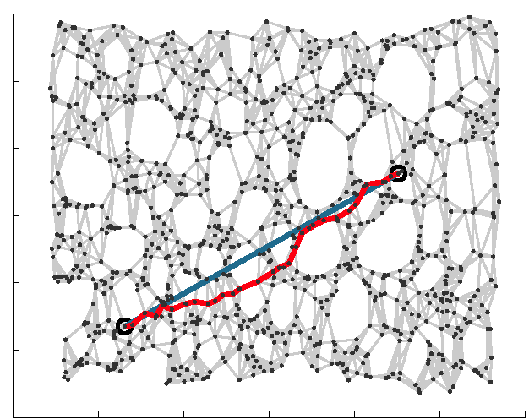
ISOMAP
ISOMAP (Isometric feature Mapping)
Preserves the intrinsic geometry of the data.
Uses the geodesic manifold distances between all pairs.

Slide 39
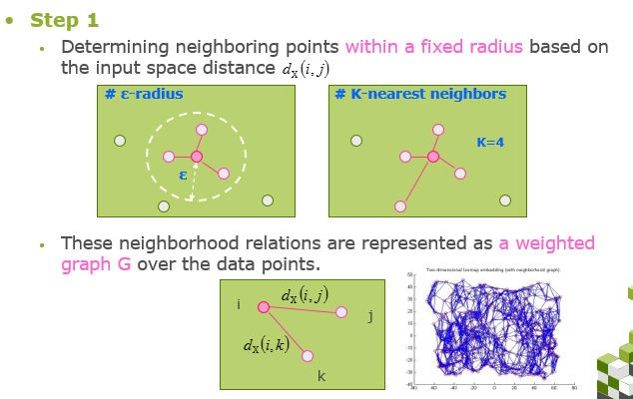
ISOMAP

Slide 40
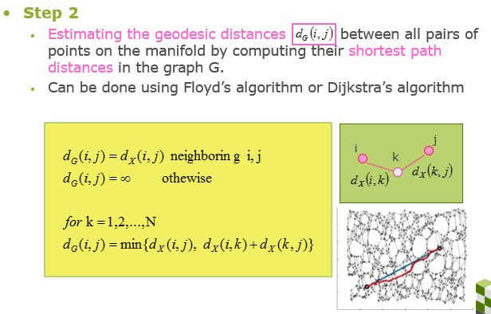
ISOMAP

Slide 41
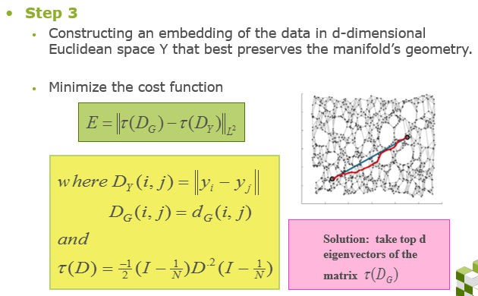

ISOMAP

Slide 42
Manifold Recovery Guarantee of ISOMAP
Isomap is guaranteed asymptotically to recover the true dimensionality
and geometric structure of nonlinear manifolds.
As the sample data points increases, the graph distances provide increasingly better approximations to the intrinsic geodesic distances.

Slide 43
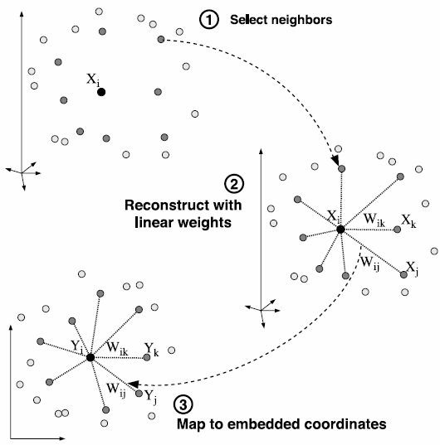


LLE: Local Linear Embedding

Slide 44







LLE: Solution
https://www.cs.nyu.edu/~roweis/lle/papers/lleintro.pdf Reconstruct linear weights w:
Local covariance matrix:
Map to embedded coordinates Y:
Bottom d+1 eigen vectors of
,discard bottom 1, which is unit vector

Slide 45
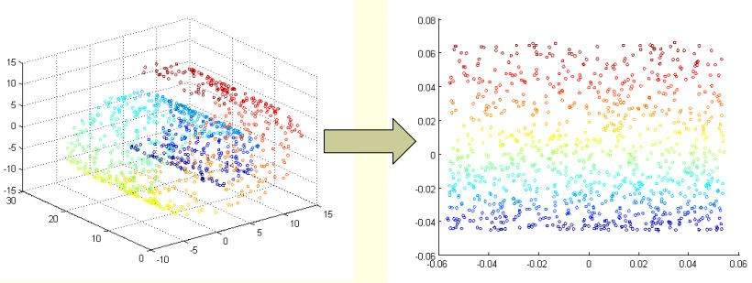
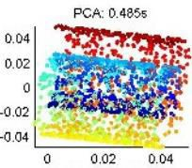
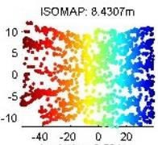
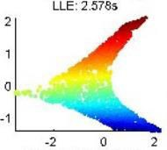
PCA vs. ISOMAP vs. LLE

Slide 46
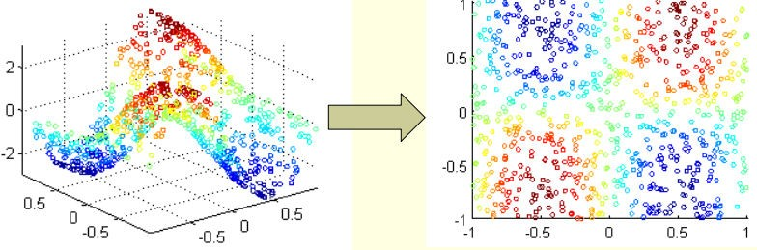
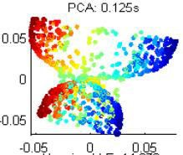
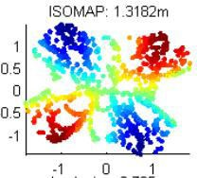
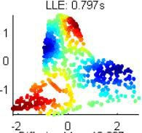
PCA vs. ISOMAP vs. LLE

Slide 47
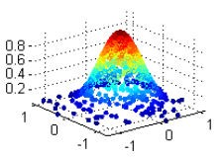
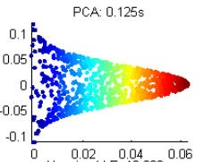
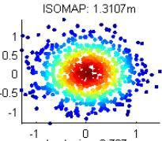
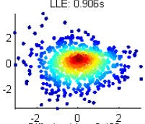
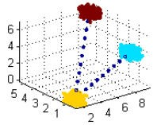
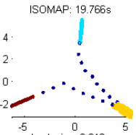
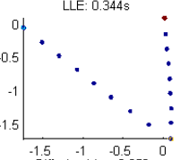
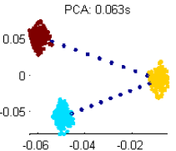
PCA vs. ISOMAP vs. LLE

Slide 48
Designing your own dimension reduction!
High dimensional representation of data
Geodesic distance
Local linear weighted representation
Low dimensional representation of data
Euclidean distance
Local linear weighted representation
Cost function between High and Low dimensional
representation

Slide 49
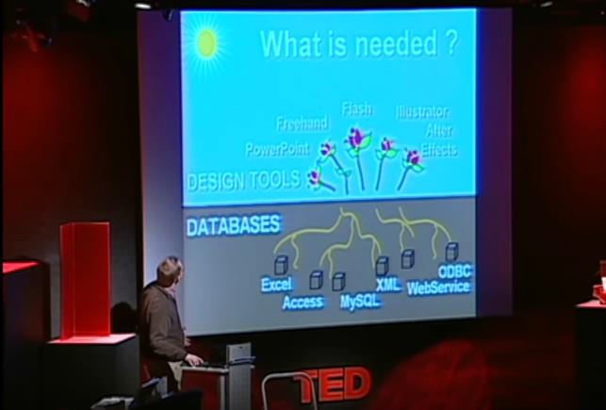
Story-telling through data visualization
https://www.youtube.com/watch?v=usdJgEwMinM

Slide 50
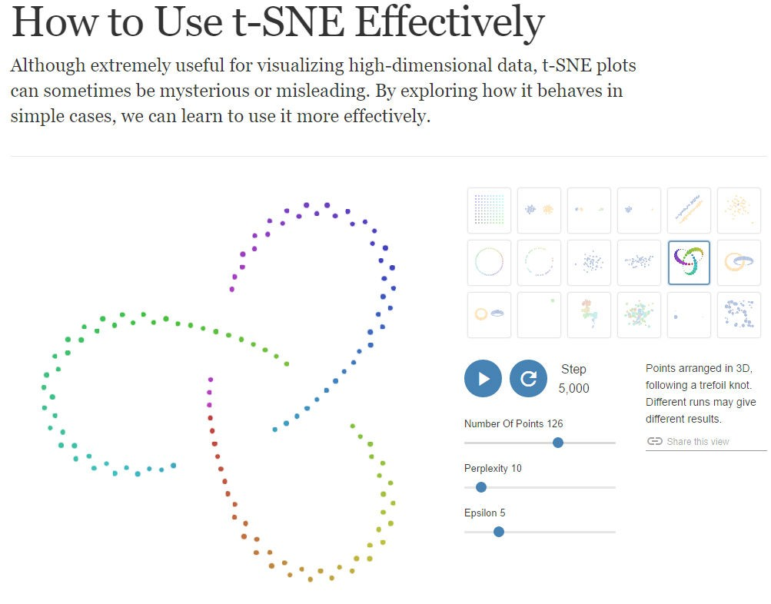
tSNE
tSNE (t-distributed Stochastic Neighbor Embedding)
more stable and faster solution
easier implementation
MDS SNE
Local+probability
2002
sym SNE UNI-SNE
crowding problem
2007
tSNE
Barnes-Hut-SNE
O(N²)->O(NlogN)
2008
2013
Explore tSNE simple cases:
http://distill.pub/2016/misread-tsne/

Slide 51
Stochastic Neighbor Embedding (SNE)
It is more important to get local distances right than non-local ones.
Stochastic neighbor embedding has a probabilistic way of deciding if a
pairwise distance is 䇾local䇿.
Convert each high-dimensional similarity into the probability that one data point will pick the other data point as its neighbor.
−||x_{i} −x _{j} ||² 2σ ²
−|| y − y ||²
probability of picking j given i in high D
e
i
e
i j
probability of picking j given i in low D
p =
q =
j|i
−||x_{i} −x_{k} ||² 2σ ²
j|i
_{∑ e}−|| y_{i} − y_{k} ||
k
2
∑ e
k
i

Slide 52


Picking the radius of the Gaussian that is used
to compute the p’s
We need to use different radii in different parts of the space so that we
keep the effective number of neighbors about constant.
A big radius leads to a high entropy for the distribution over neighbors of i. A small radius leads to a low entropy.
So decide what entropy you want and then find the radius that produces that entropy.
Its easier to specify perplexity:
−||x_{i} −x _{j} ||² 2σ ²
e
i
p =
j|i
−||x_{i} −x_{k} ||² 2σ ²
∑ e
k
i

Slide 53

The cost function for a low-dimensional
representation
^{p} j|i
Cost =
∑
i
KL(P || Q ) = ∑ ∑ p | log
i
i
j i
^{q} j|i
i j
Gradient descent:
∂C
= 2
∑
(y _{j} − y_{i} ) ( p _{j|i} − q _{j|i} + p_{i| j} − q_{i| j} )
∂y
i
j
Gradient update with a momentum term:
Learning rate
Momentum

Slide 54
Turning conditional probabilities into pairwise
probabilities
−||x_{i} −x _{j} ||² 2σ ²
−||x_{i} −x _{j} ||² 2σ ²
e
i
e
p =
p =
j|i
−||x_{i} −x_{k} ||² 2σ ²
ij
−||x −x ||² 2σ ²
∑ e
k
i
∑ e
k ≠l
k l
p
p log ^{ij}
Cost = KL(P || Q) =
∑
ij
^{q}ij
δ C ₌
4∑( p − q
_{ij} )( y − y _{j} )
δ y_{i}
ij
i
j

Slide 55
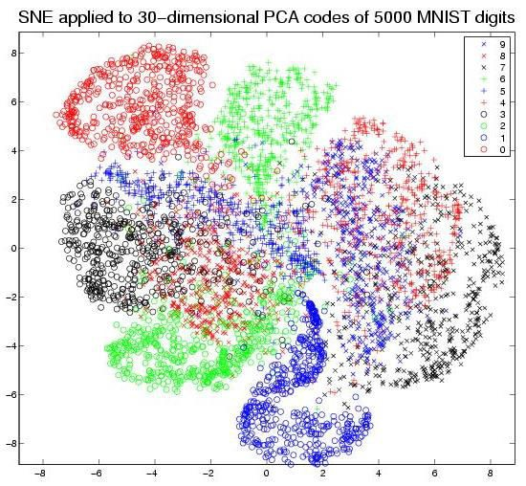
MNIST
Database
of handwritten
digits
28×28 images
Problem? Too crowded!

Slide 56

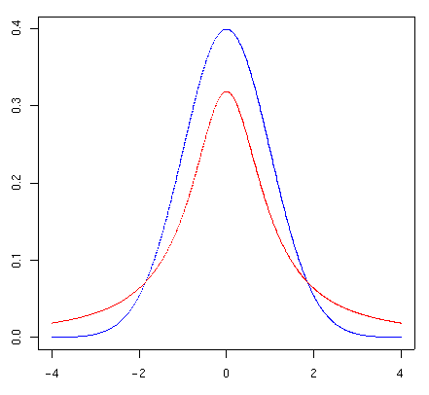
From SNE to t-SNE: solve crowding problem
High dimension: Convert distances into probabilities using a Gaussian distribution
Low dimension: Convert distances into probabilities using a
probability distribution that has much heavier tails than a Gaussian.
Student’s t-distribution
V : the number of degrees of freedom
Standard Normal Dis.
T-Dis. With
V = 1
(1+ || y − y ||² )⁻¹
^{q}ij
=
i j
∑
k ≠l
(1+ || y − y ||² )⁻¹
k l

Slide 57
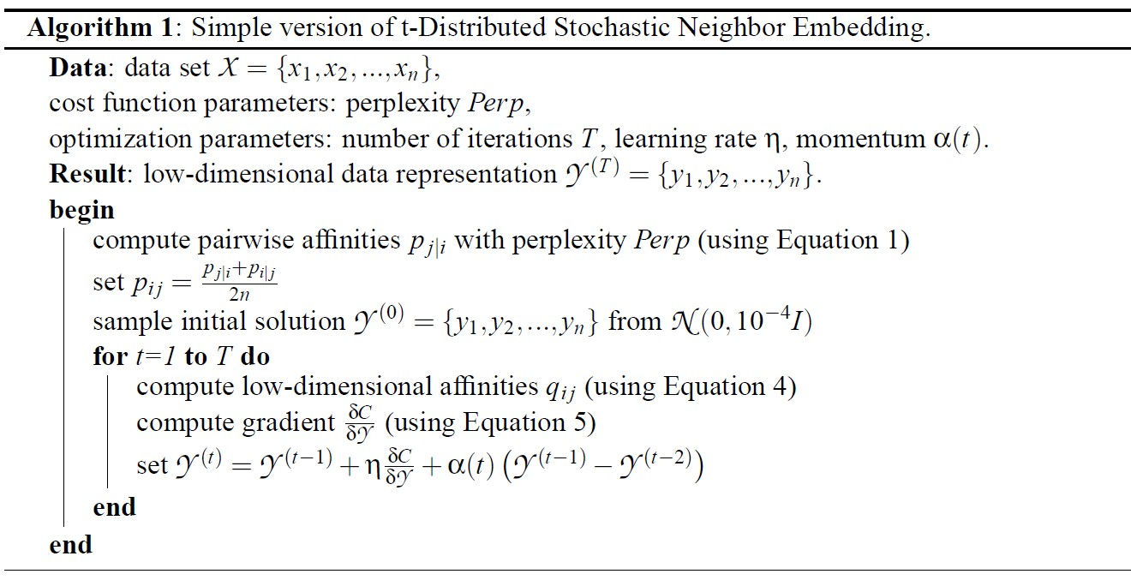
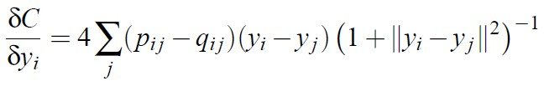
Optimization method for tSNE
−||x_{i} −x _{j} ||² 2σ ²
₌ e
(1+ || y − y ||² )⁻¹
p
^{q}ij
=
i j
ij
2
2
∑ e
k ≠l
−||x_{k} −x_{l} || 2σ
∑
k ≠l
(1+ || y − y ||² )⁻¹
k l

Slide 58
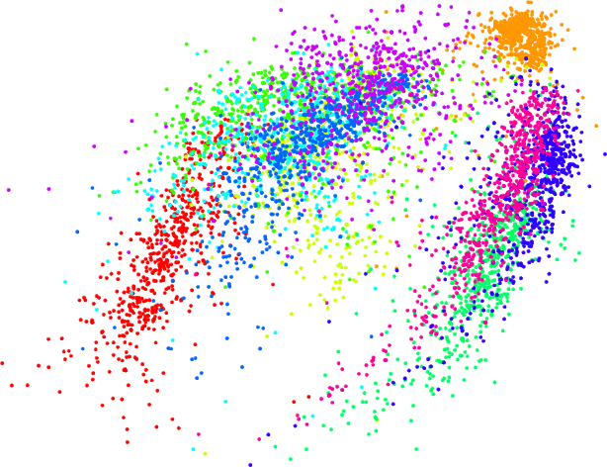
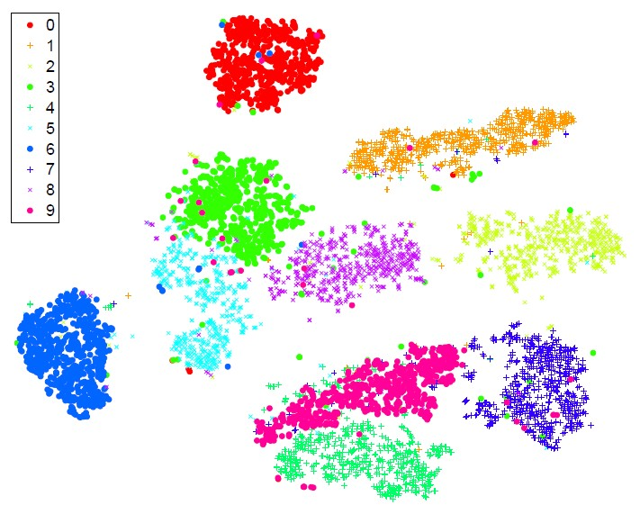
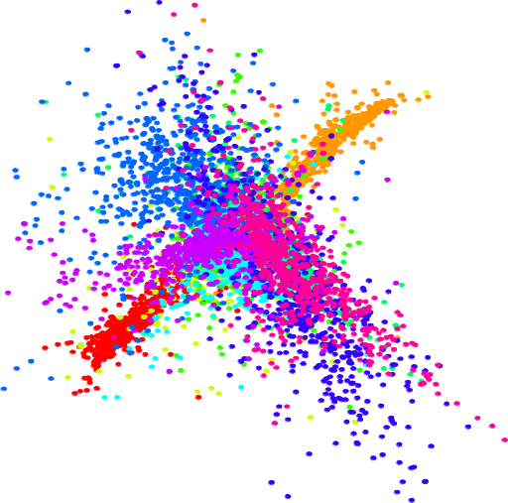
Isomap
6000 MNIST digits
t-SNE
LLE

Slide 59
Weakness
It’s unclear how t-SNE performs on general dimensionality reduction task (d >3);
The relative local nature of t-SNE makes it sensitive to the curse
of the intrinsic dimensionality of the data;
It’s not guaranteed to converge to a global optimum of its cost
function.
It tends to form sub-clusters even if the data points are totally random.
Explore tSNE simple cases: http://distill.pub/2016/misread-tsne/

Slide 60
References:
t-SNE homepage:
http://homepage.tudelft.nl/19j49/t-SNE.html
Advanced Machine Learning: Lecture11: Non-linear Dimensionality Reduction http://www.cs.toronto.edu/~hinton/csc2535/lectures.html

Slide 61
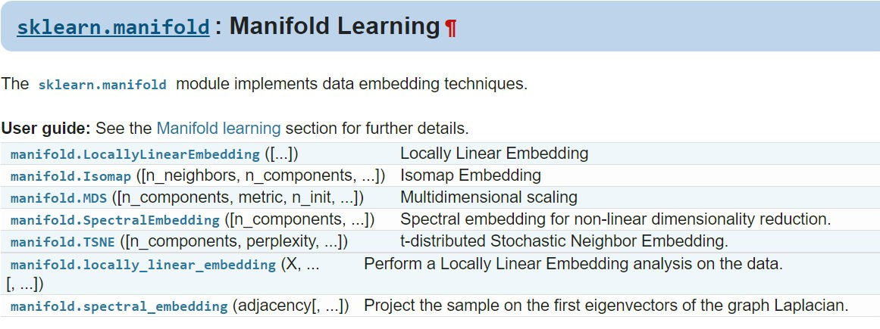
Implementation
Manifold method:
http://scikit-learn.org/stable/modules/classes.html#module-sklearn.manifold
Good examples:
http://scikit- learn.org/stable/auto_examples/manifold/plot_compare_methods.html#sphx- glr-auto-examples-manifold-plot-compare-methods-py

Slide 62
Roadmap: Method
Tour of machine learning algorithms (1 session)
Feature engineering (1 session)
Feature selection - Yan
Supervised learning (4 sessions)
Regression models -Yan
SVM and kernel SVM - Yan
Tree-based models - Dario
Bayesian method - Xiaoyang
Ensemble models - Yan
Unsupervised learning (3 sessions)
K-means clustering
DBSCAN - Cheng
Mean shift
Agglomerative clustering – Kunal
Spectral clustering – Yan
Dimension reduction for data visualization - Yan
Deep learning (4 sessions)
_ Neural network
Convolutional neural network – Hengyang Lu
Recurrent neural networks
Train deep nets with open-source tools

Slide 63


Thank you
Earlier slides at: Meetup page: More | File Later on Slides at: http://www.slideshare.net/xuyangela
Machine learning in Oil and Gas Conference @ Houston, April 19-20: https://energyconferencenetwork.com/machine-learning-oil-gas-2017/ 20% off, PROMO code: HML

